Slide 1
I/O Basics
Java programs perform I/O through streams.
A stream is an abstraction that either produces or consumes information.
A stream is linked to a physical device by the Java I/O system.
All streams behave in the same manner, even if the actual physical devices to which they are linked differ.
Thus, the same I/O classes and methods can be applied to any type of device. This means that an input stream can abstract many different kinds of input: from a disk file, a keyboard, or a network socket
Likewise, an output stream may refer to the console, a disk file, or a network connection.

Slide 2
Byte Streams and Character Streams
Java 2 defines two types of streams: byte and character.
Byte streams:- provide a convenient means for handling input and output of bytes. Byte streams are used, for example, when reading or writing binary data.
Character streams:- provide a convenient means for handling input and output of characters. They use Unicode and, therefore, can be internationalized. Also, in some cases, character streams are more efficient than byte streams.

Slide 3
The Byte Stream Classes
Byte streams are defined by using two class hierarchies. At the top are two abstract classes: InputStream and OutputStream.
Each of these abstract classes has several concrete subclasses, that handle the differences between various devices, such as disk files, network connections, and even memory buffers.

Slide 4
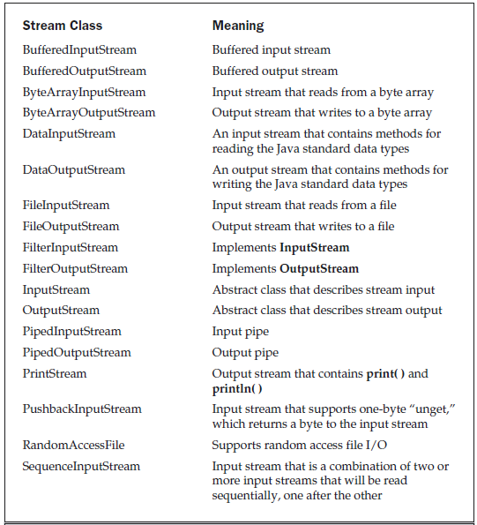
Byte Stream classes

Slide 5
Character Stream Classes
Character streams are defined by using two class hierarchies. At the top are two abstract classes, Reader and Writer.
These abstract classes handle Unicode character streams.
Java has several concrete subclasses of each of these.

Slide 6
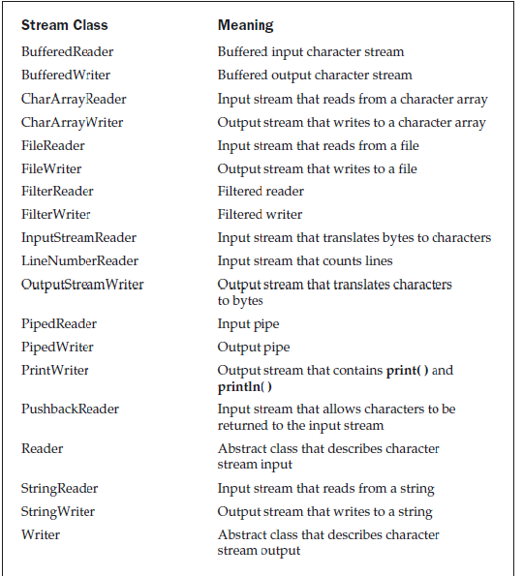
Character Stream Classes

Slide 7
Reading Console Input
In Java 1.0, the only way to perform console input was to use a byte stream, and older code that uses this approach persists. Today, using a byte stream to read console input is still technically possible, but doing so may require the use of a deprecated method, and this approach is not recommended. The preferred method of reading console input for Java 2 is to use a character-oriented stream, which makes your program easier to internationalize and maintain.

Slide 8
Contd…
In Java, console input is accomplished by reading from System.in. To obtain a character-based stream that is attached to the console, you wrap System.in in a BufferedReader object, to create a character stream.
BuffereredReader supports a buffered input stream.
Its most commonly used constructor is shown here:
BufferedReader(Reader inputReader)

Slide 9
Here, inputReader is the stream that is linked to the instance of BufferedReader that is being created.
Reader is an abstract class. One of its concrete subclasses is InputStreamReader, which converts bytes to characters. To obtain an InputStreamReader object that is linked to System.in, use the following constructor:
InputStreamReader(InputStream inputStream1)
Because System.in refers to an object of type InputStream, it can be used for inputStream.

Slide 10
Putting it all together, the following line of code creates a BufferedReader that is connected to the keyboard:
BufferedReader br = new BufferedReader(new
InputStreamReader(System.in));
After this statement executes, br is a character-based stream that is linked to the console through System.in.

Slide 11
Reading Characters
To read a character from a BufferedReader, use read( ). The version of read( ) that we will be using is
int read( ) throws IOException
Each time that read( ) is called, it reads a character from the input stream and returns it as an integer value.
It returns –1 when the end of the stream is encountered.
The following program demonstrates read( ) by reading characters from the console until the user types a “q”:

Slide 12
// Use a BufferedReader to read characters from the console.
import java.io.*;
class BRRead
{
public static void main(String args[]) throws IOException
{
char c;
BufferedReader br = new BufferedReader
(new InputStreamReader(System.in));
System.out.println("Enter characters, 'q' to quit.");
// read characters
do {
c = (char) br.read();
System.out.println(c);
} while(c != 'q');
}
}

Slide 13
output
Enter characters, 'q' to quit.
123abcq
1
2
3
a
b
c
q

Slide 14
Reading Strings
To read a string from the keyboard, use the version of readLine( ) that is a member of the BufferedReader class. Its general form is shown here:
String readLine( ) throws IOException
// Read a string from console using a BufferedReader.
import java.io.*;
class BRReadLines {
public static void main(String args[])
throws IOException
{
// create a BufferedReader using System.in
BufferedReader br = new BufferedReader(new
InputStreamReader(System.in));

Slide 15
String str;
System.out.println("Enter lines of text.");
System.out.println("Enter 'stop' to quit.");
do {
str = br.readLine();
System.out.println(str);
} while(!str.equals("stop"));
}
}

Slide 16
Writing Console Output
Console output is most easily accomplished with print( ) and println( ) These methods are defined by the class PrintStream (which is the type of the object referenced by System.out).
Even though System.out is a byte stream, using it for simple program output is still acceptable.
Because PrintStream is an output stream derived from OutputStream, it also implements the low-level method write( ).
write( ) can be used to write to the console. The simplest form of write( ) defined by PrintStream is shown here:
void write(int byteval)

Slide 17
// Demonstrate System.out.write().
class WriteDemo {
public static void main(String args[]) {
int b;
b = 'A';
System.out.write(b);
System.out.write('\n');
}
}

Slide 18
The PrintWriter Class
Although using System.out to write to the console is still permissible under Java, its use is recommended mostly for debugging purposes or for sample programs. For real-world programs, the recommended method of writing to the console when using Java is through a PrintWriter stream.
PrintWriter defines several constructors. The one we will use is shown here:
PrintWriter(OutputStream outputStream, boolean flushOnNewline)

Slide 19
Contd…
Here, outputStream is an object of type OutputStream, and flushOnNewline controls whether Java flushes the output stream every time a println( ) method is called.
If flushOnNewline is true, flushing automatically takes place. If false, flushing is not automatic.
To write to the console by using a PrintWriter, specify System.out for the output stream and flush the stream after each newline.
For example, this line of code creates a PrintWriter that is connected to console output:
PrintWriter pw = new PrintWriter(System.out, true);

Slide 20
The following example illustrates using a PrintWriter to handle console output:
// Demonstrate PrintWriter
import java.io.*;
public class PrintWriterDemo {
public static void main(String args[]) {
PrintWriter pw = new PrintWriter(System.out, true);
pw.println("This is a string");
int i = -7;
pw.println(i);
double d = 4.5e-7;
pw.println(d);
}
}

Slide 21
output
The output from this program is shown here:
This is a string
-7
4.5E-7

Slide 22
Reading and Writing Files
Java provides a number of classes and methods that allow you to read and write files.
In Java, all files are byte-oriented, and Java provides methods to read and write bytes from and to a file. However, Java allows you to wrap a byte-oriented file stream within a character-based object.
Two of the most often-used stream classes are FileInputStream and FileOutputStream, which create byte streams linked to files.
To open a file, you simply create an object of one of these classes, specifying the name of the file as an argument to the constructor.

Slide 23
Contd..
While both classes support additional, overridden constructors, the following are the forms that we will be using:
FileInputStream(String fileName) throws FileNotFoundException
FileOutputStream(String fileName) throws FileNotFoundException
Here, fileName specifies the name of the file that you want to open. When you create an input stream, if the file does not exist, then FileNotFoundException is thrown.
For output streams, if the file cannot be created, then FileNotFoundException is thrown.

Slide 24
Contd…
When you are done with a file, you should close it by calling close( ). It is defined by both FileInputStream and FileOutputStream, as shown here:
void close( ) throws IOException
To read from a file, you can use a version of read( ) that is defined withinFileInputStream. The one that we will use is shown here:
int read( ) throws IOException

Slide 25
/* Display a text file.
import java.io.*;
class ShowFile {
public static void main(String args[])
throws IOException
{
int i;
FileInputStream fin;
try {
fin = new FileInputStream(args[0]);
}
catch(FileNotFoundException e)
{
System.out.println("File Not Found");
return;
} catch(ArrayIndexOutOfBoundsException e) {
System.out.println("Usage: ShowFile File");
return;
}

Slide 26
Contd..
// read characters until EOF is encountered
do {
i = fin.read();
if(i != -1)
System.out.print((char) i);
} while(i != -1);
fin.close();
}
To use this program, specify the name of the file that you want to see.
For example, to see a file called TEST.TXT, use the following command line.
java ShowFile TEST.TXT

